Slide 1
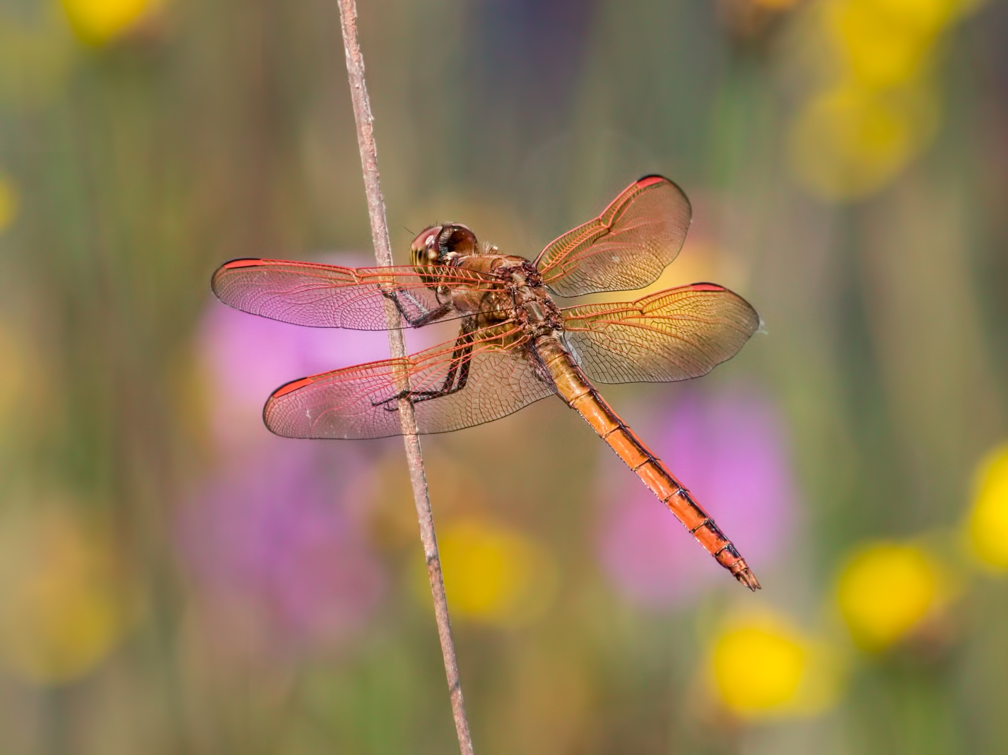
Dragonfly ID Quiz
Click to Start Quiz

Slide 2
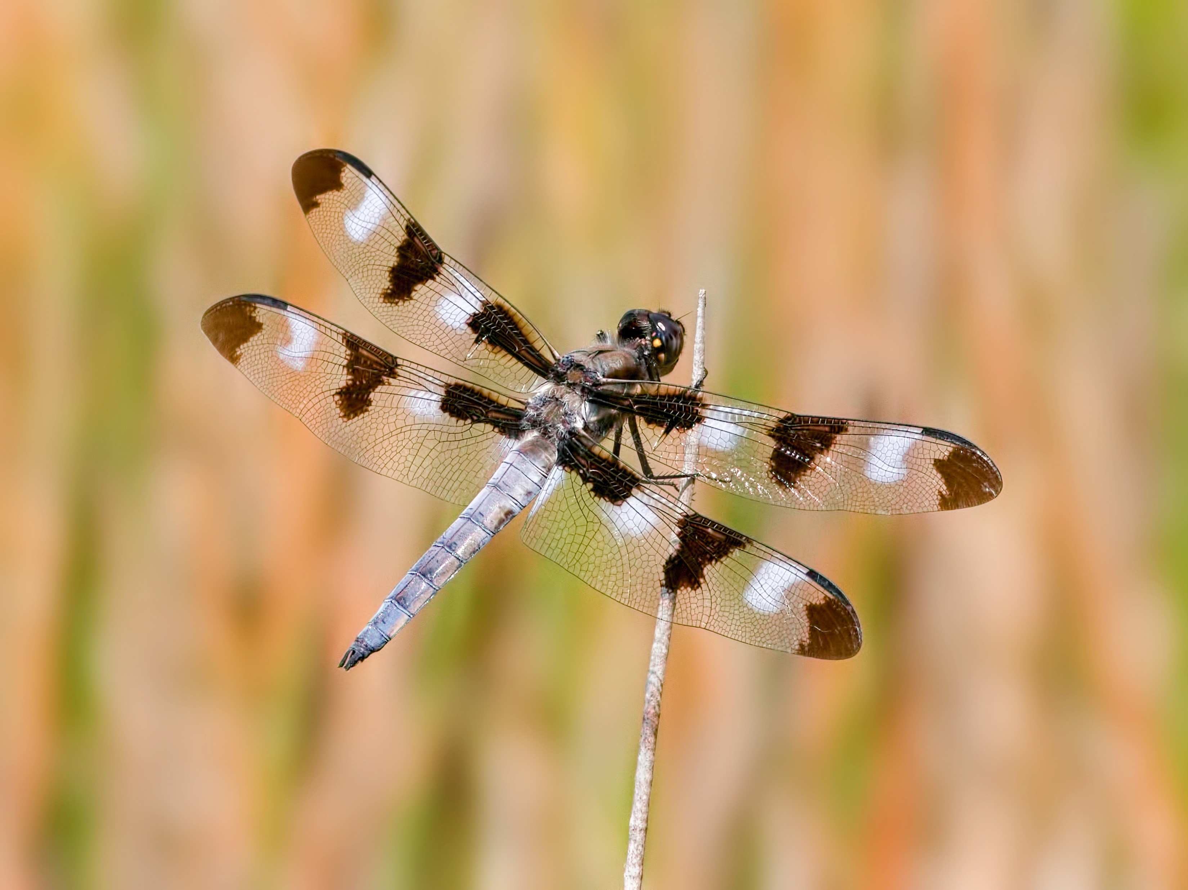
Dragonfly ID Quiz
Twelve-spotted Skimmer
Common Whitetail
Needham’s Skimmer
Prince Baskettail
Question 1/10
0/10 Correct

Slide 3
Dragonfly ID Quiz
Twelve-spotted Skimmer
Common Whitetail
Needham’s Skimmer
Prince Baskettail
Correct
Click here to advance
Question 1/10
0/10 Correct

Slide 4
Dragonfly ID Quiz
Twelve-spotted Skimmer
Common Whitetail
Needham’s Skimmer
Prince Baskettail
Incorrect
Twelve-spotted Skimmer is correct
Click here to advance
Question 1/10
0/10 Correct

Slide 5
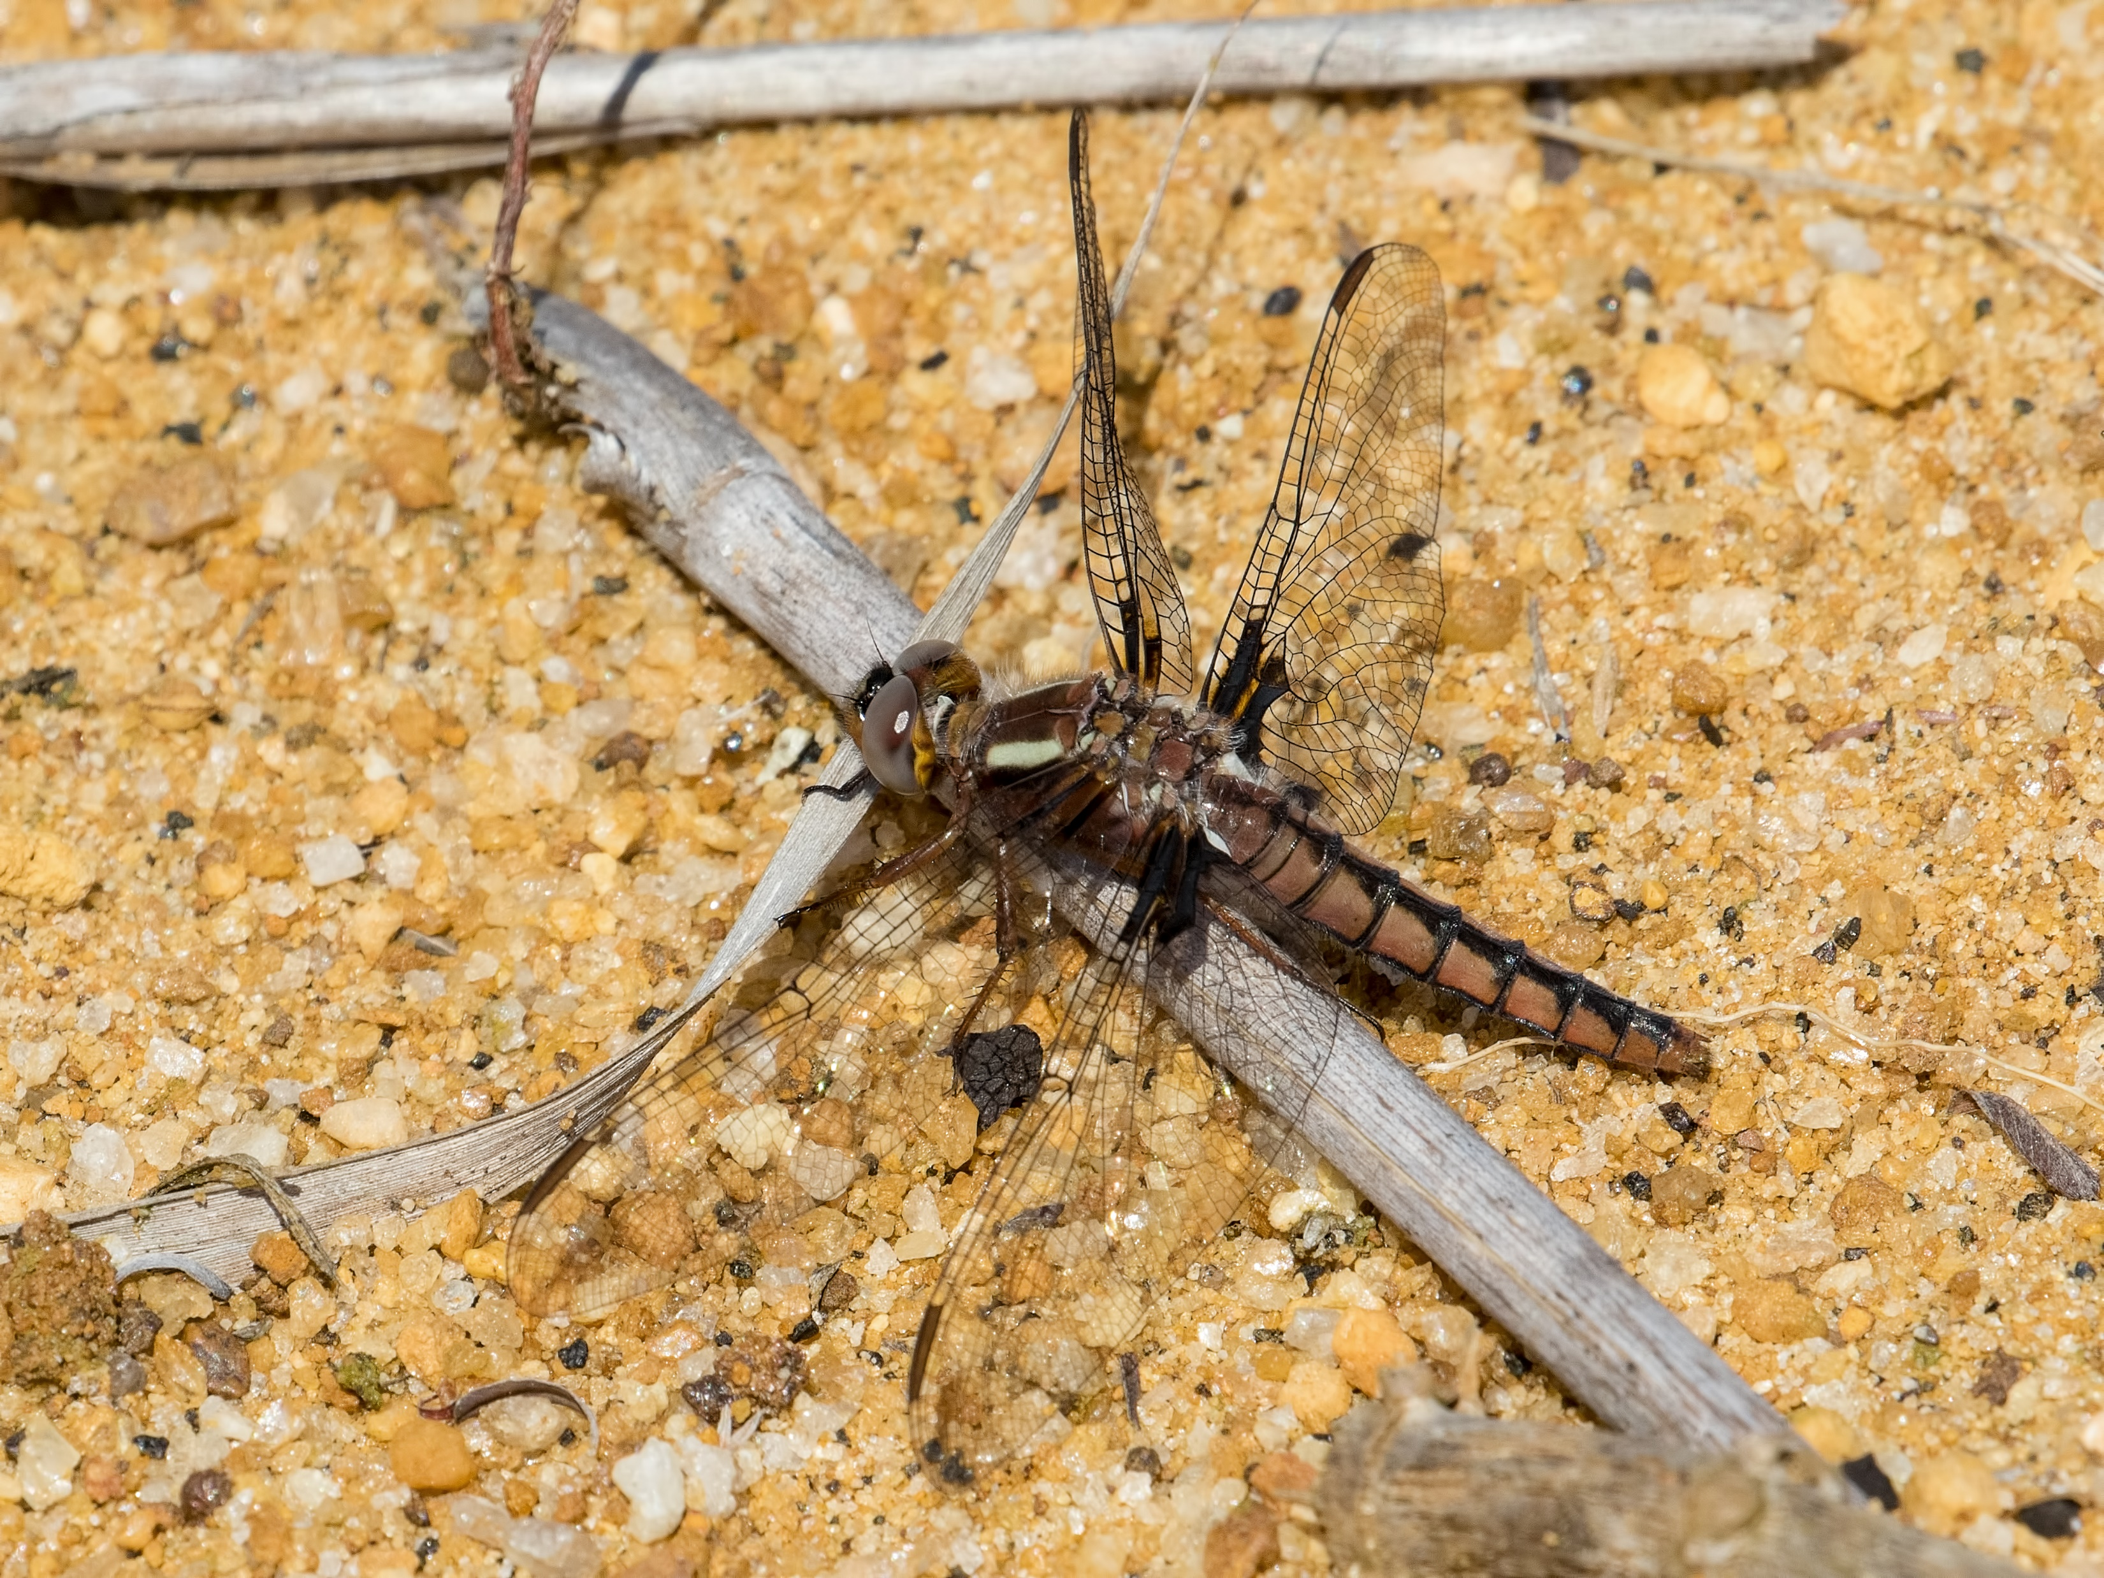
Dragonfly ID Quiz
White Corporal
Common Whitetail
Blue Corporal
Common Baskettail
Question 2/10
0/10 Correct

Slide 6
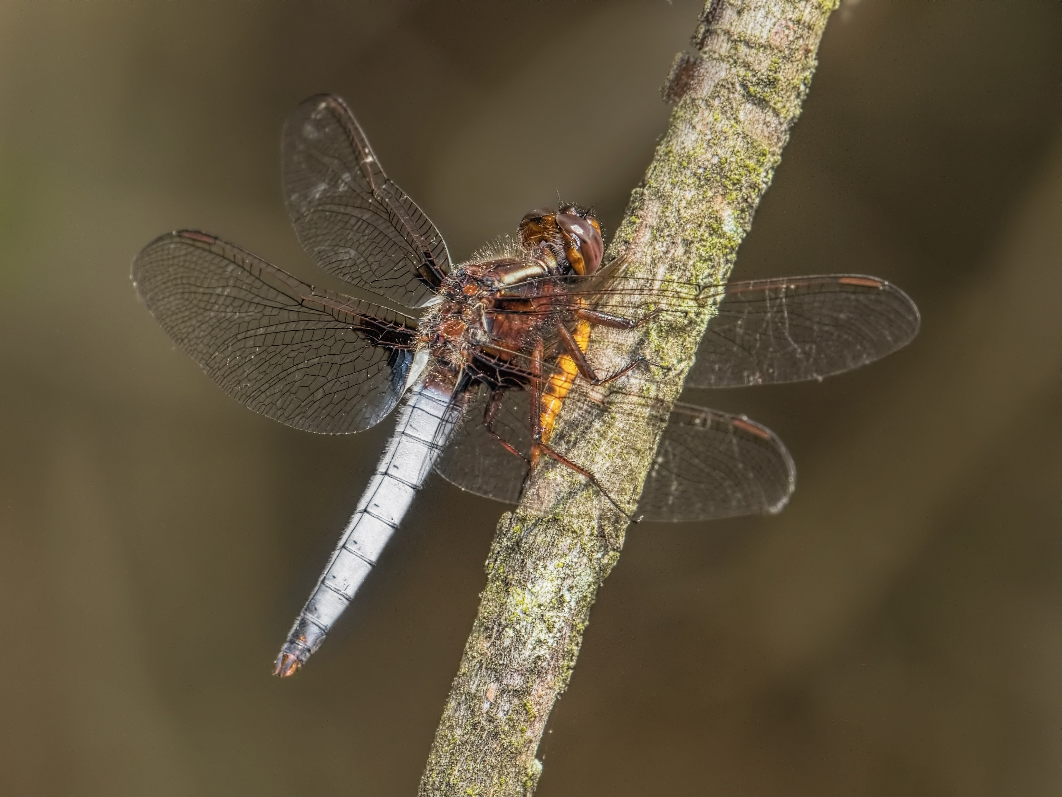
Dragonfly ID Quiz
Great Blue Skimmer
Common Whitetail
Widow Skimmer
White Corporal
Question 3/10
0/10 Correct

Slide 7
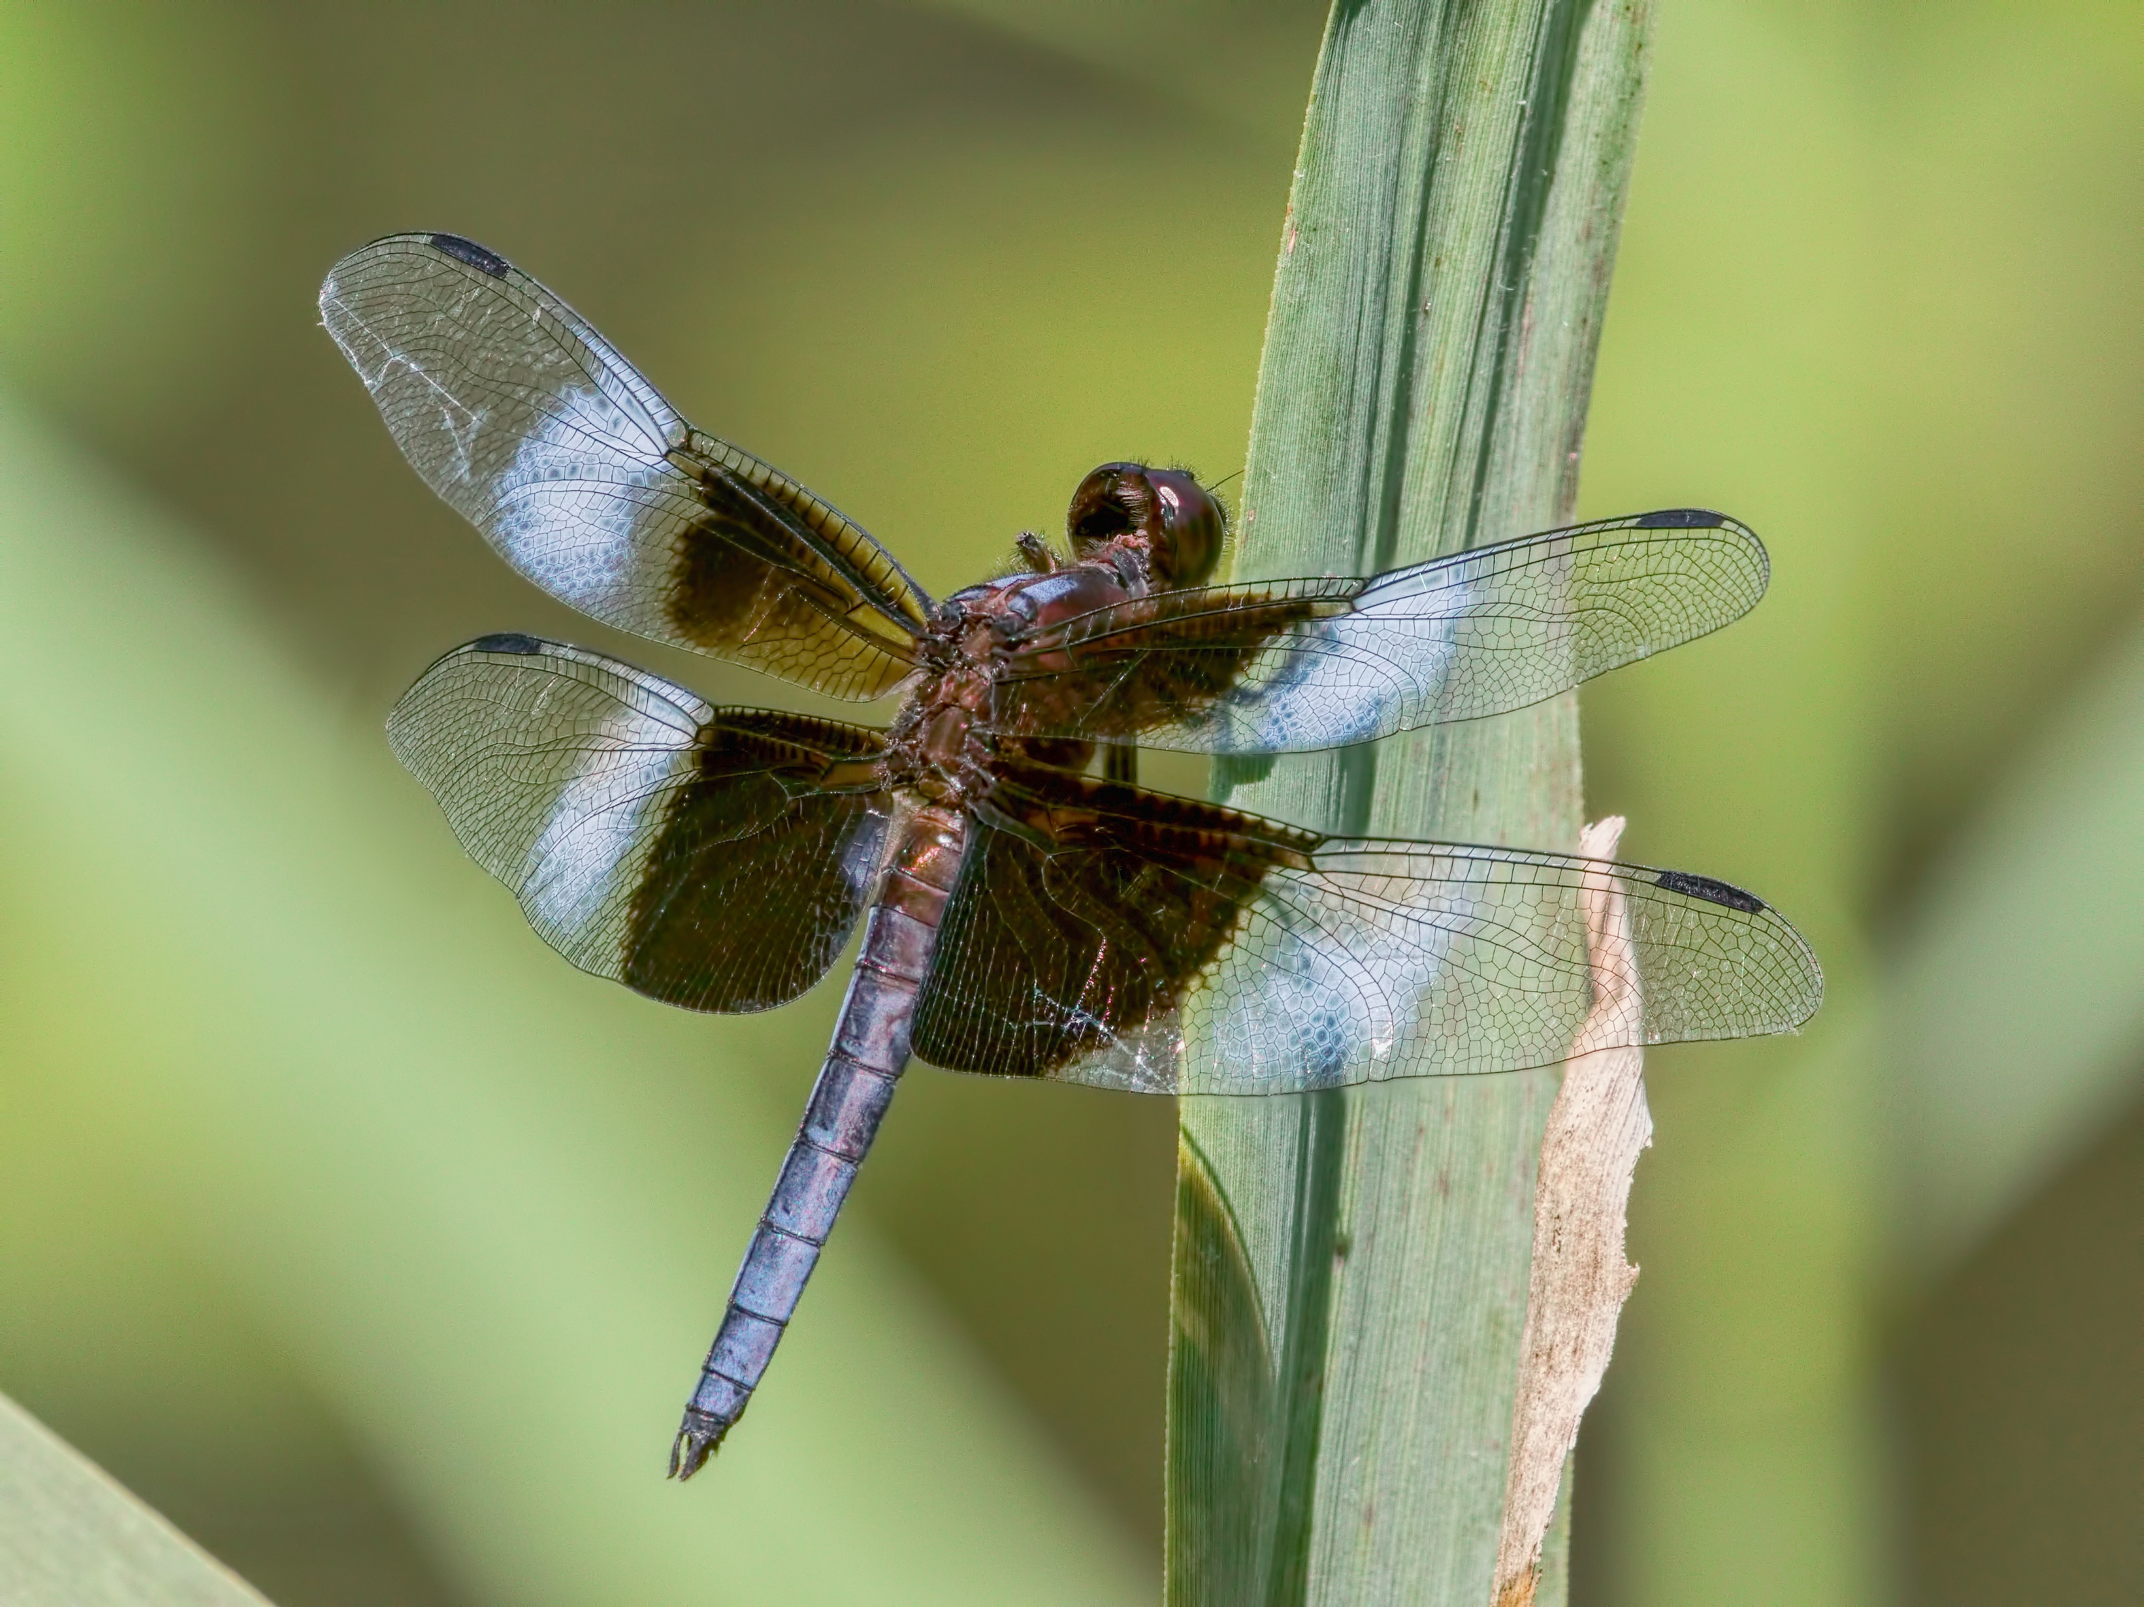
Dragonfly ID Quiz
Twelve-spotted Skimmer
Common Whitetail
Widow Skimmer
White Corporal
Question 4/10
0/10 Correct

Slide 8
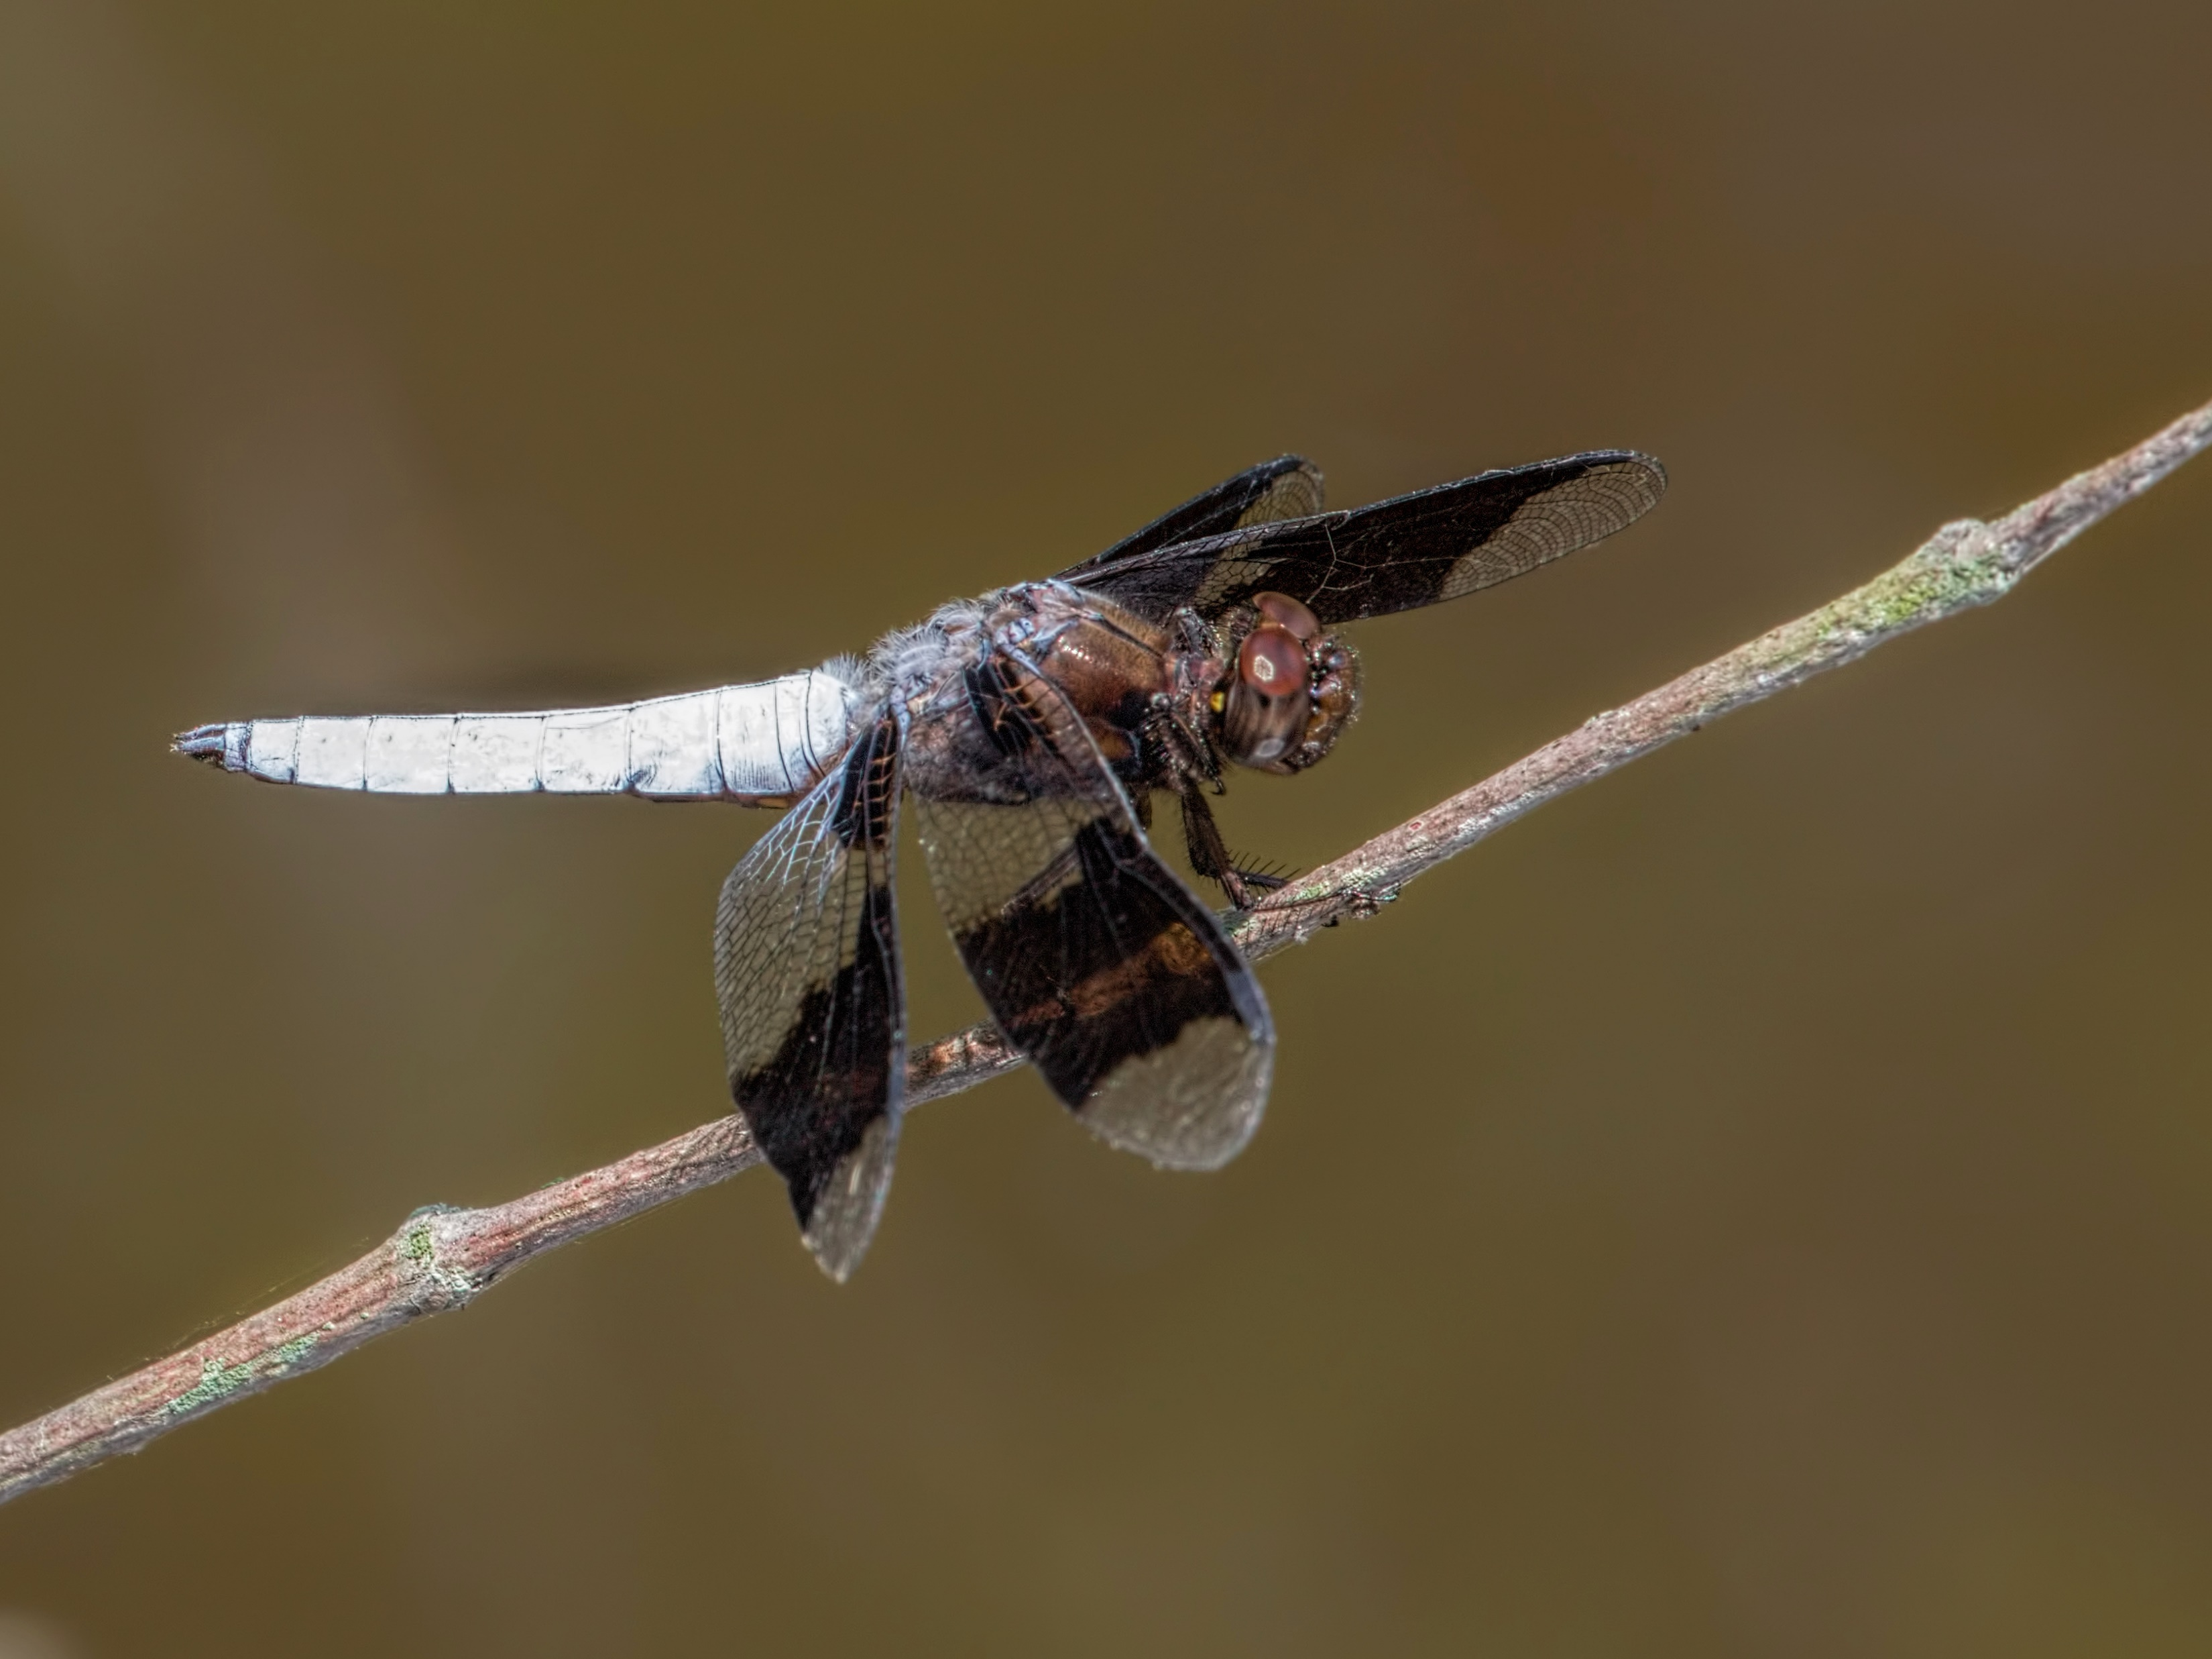
Dragonfly ID Quiz
Twelve-spotted Skimmer
Common Whitetail
Chalk-fronted Corporal
Widow Skimmer
Question 5/10
0/10 Correct

Slide 9
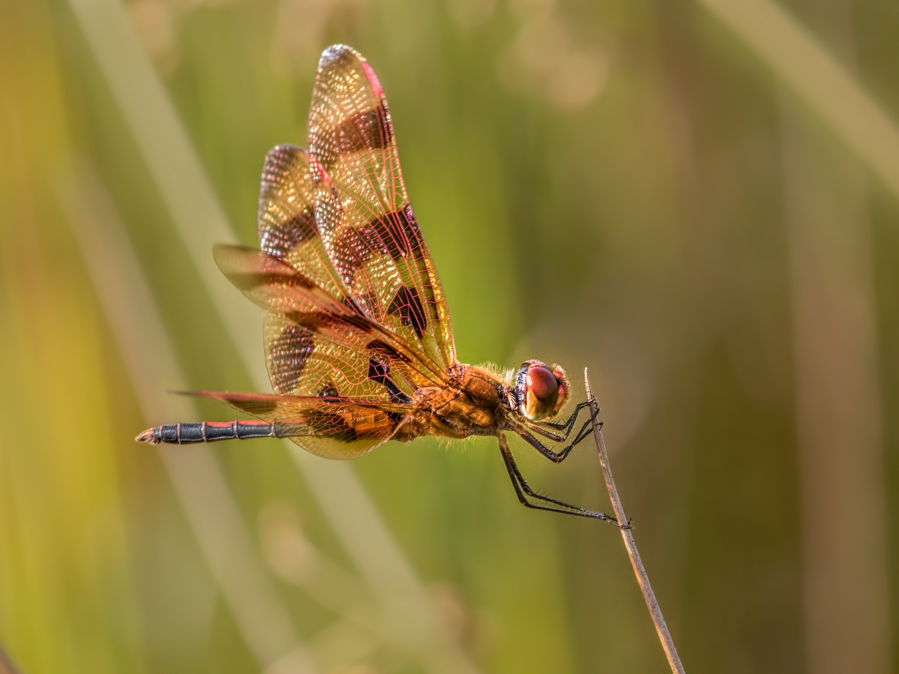
Dragonfly ID Quiz
Halloween Pennant
Calico Pennant
Painted Skimmer
Prince Baskettail
Question 6/10
0/10 Correct

Slide 10
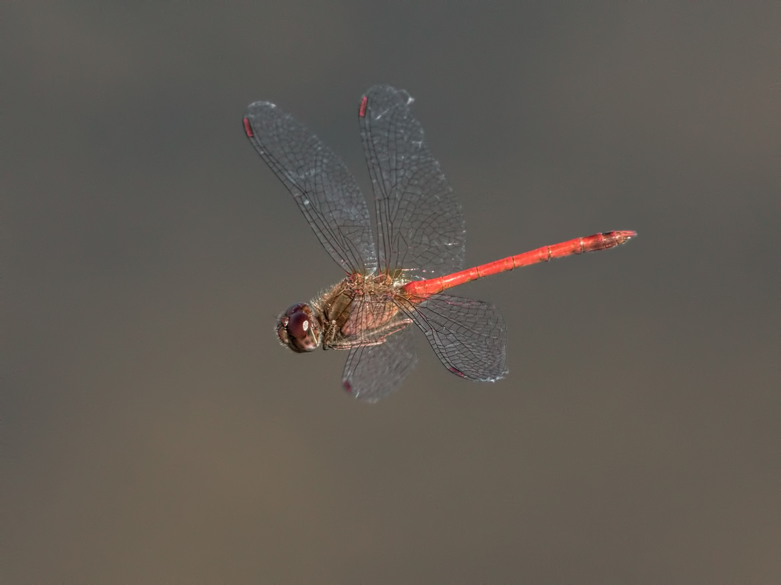
Dragonfly ID Quiz
Blue-faced Meadowhawk
Needham’s Skimmer
Carolina Saddlebags
Autumn Meadowhawk
Question 7/10
0/10 Correct

Slide 11
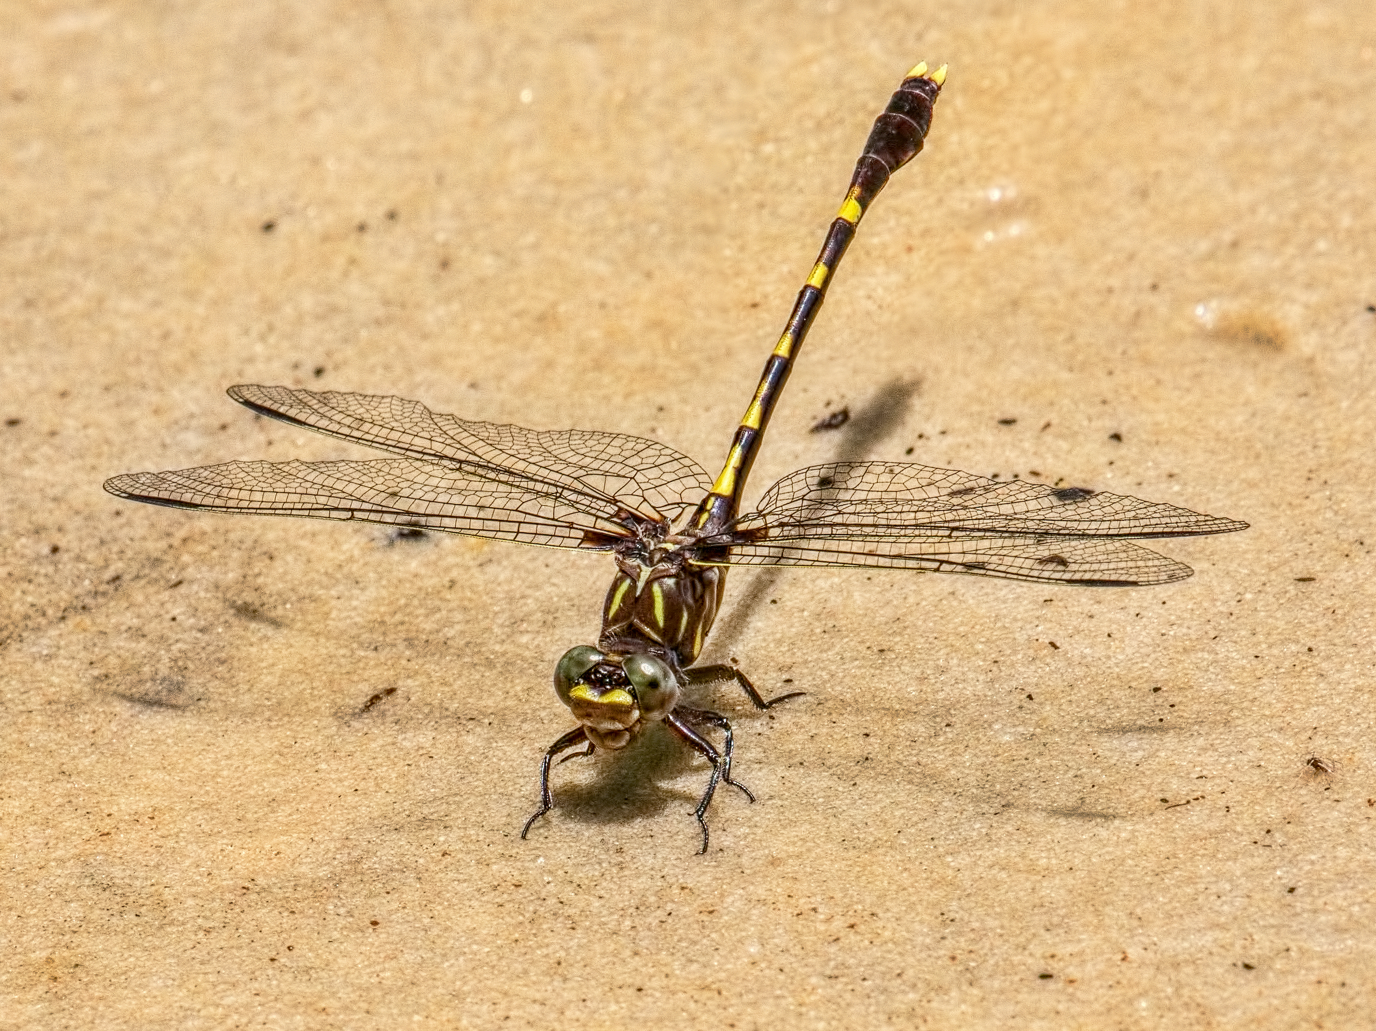
Dragonfly ID Quiz
Dragonhunter
Common Sanddragon
Cobra Clubtail
Lancet Clubtail
Question 8/10
0/10 Correct

Slide 12
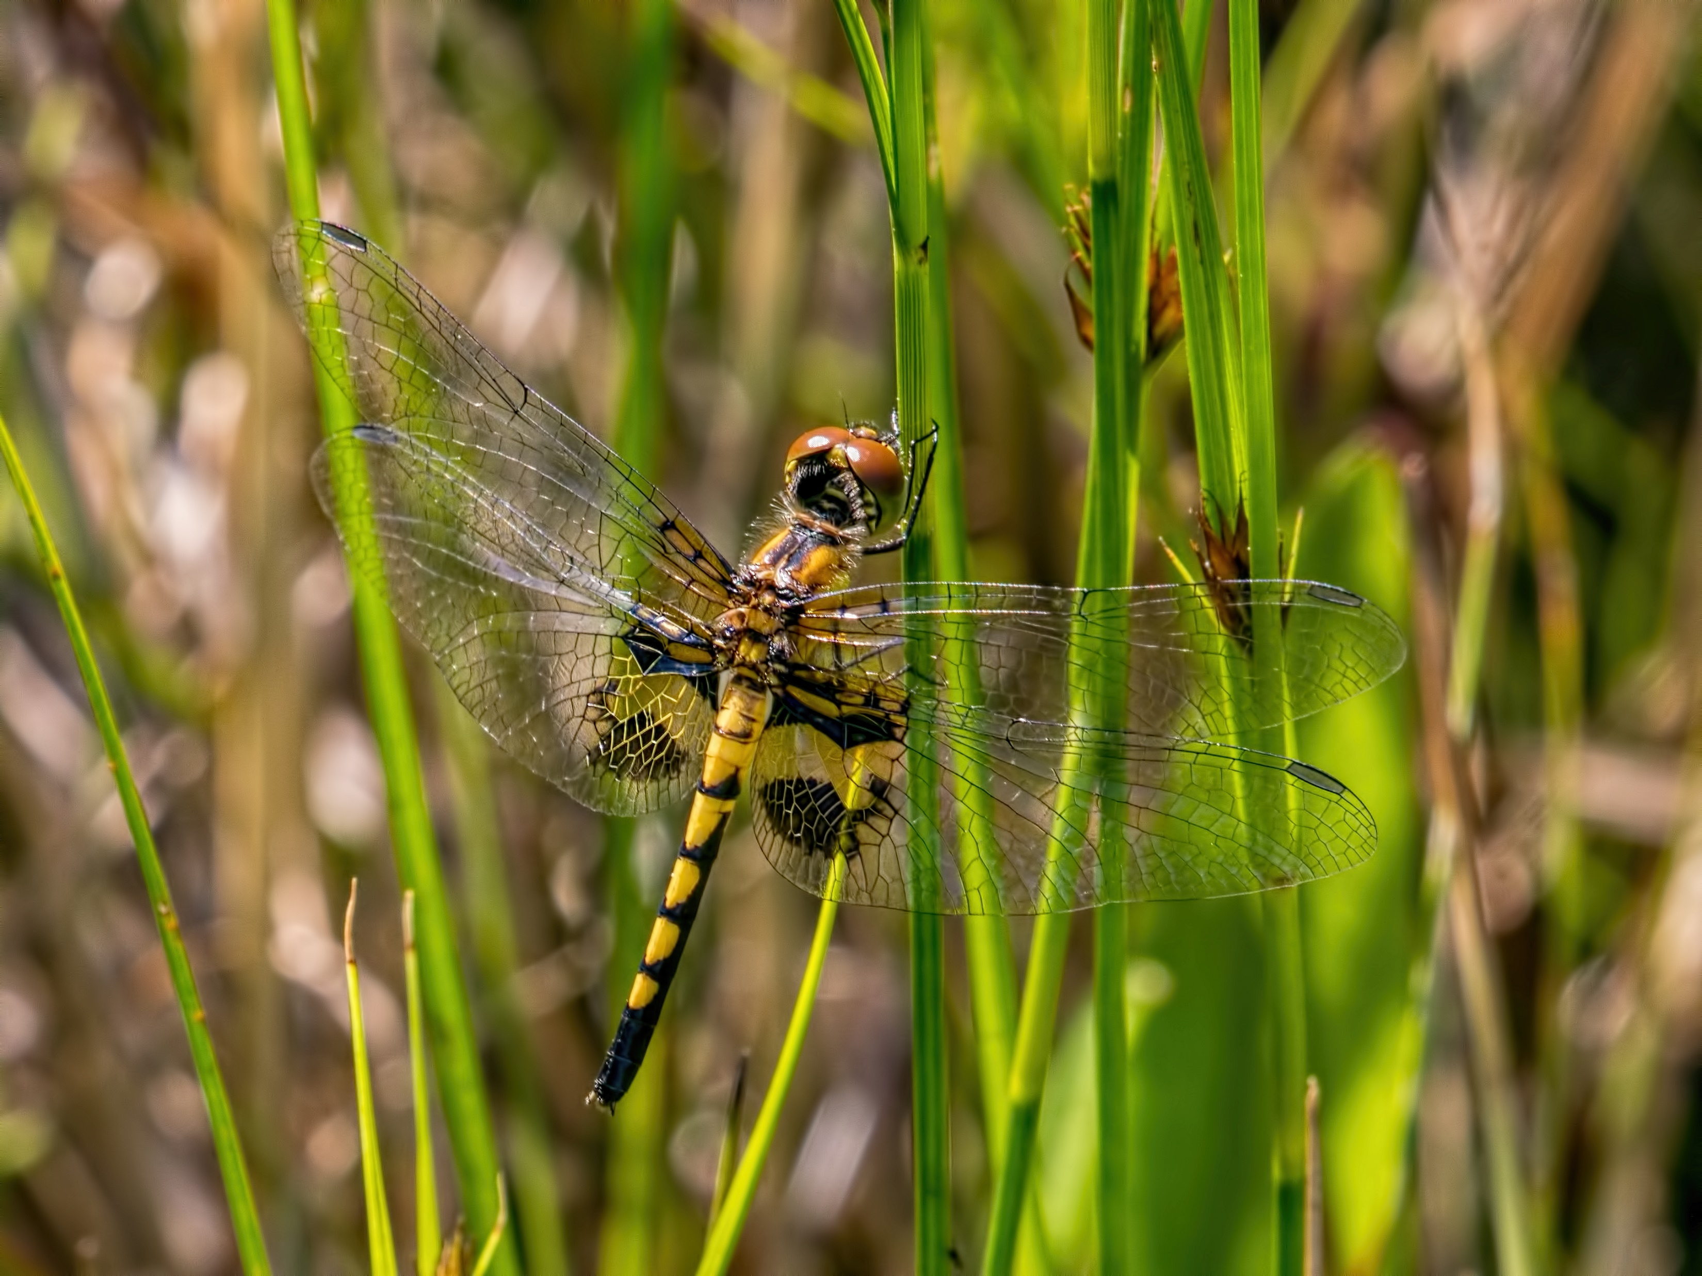
Dragonfly ID Quiz
Ornate Pennant
Calico Pennant
Black Saddlebags
Martha’s Pennant
Question 9/10
0/10 Correct

Slide 13
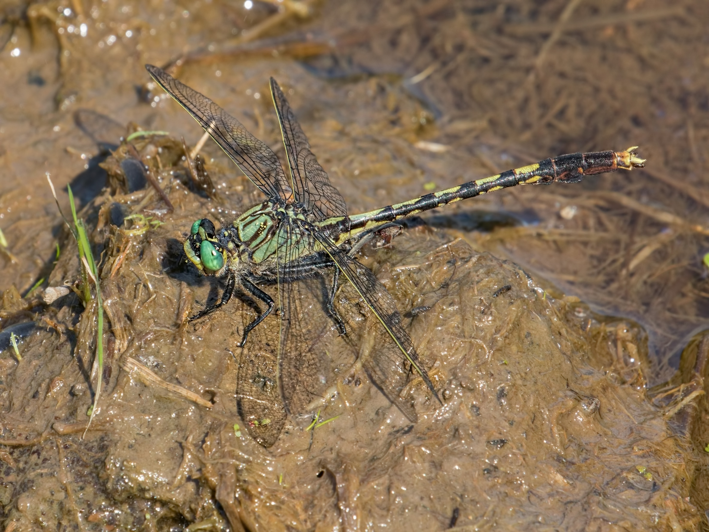
Dragonfly ID Quiz
Dragonhunter
Riffle Snaketail
Eastern Ringtail
Unicorn Clubtail
Question 10/10
0/10 Correct

Slide 14
Dragonfly ID Quiz
Twelve-spotted Skimmer
Common Whitetail
Needham’s Skimmer
Prince Baskettail
Question 1/10
0/10 Correct

Slide 15
Dragonfly ID Quiz
Twelve-spotted Skimmer
Common Whitetail
Needham’s Skimmer
Prince Baskettail
Question 1/10
0/10 Correct

Slide 16
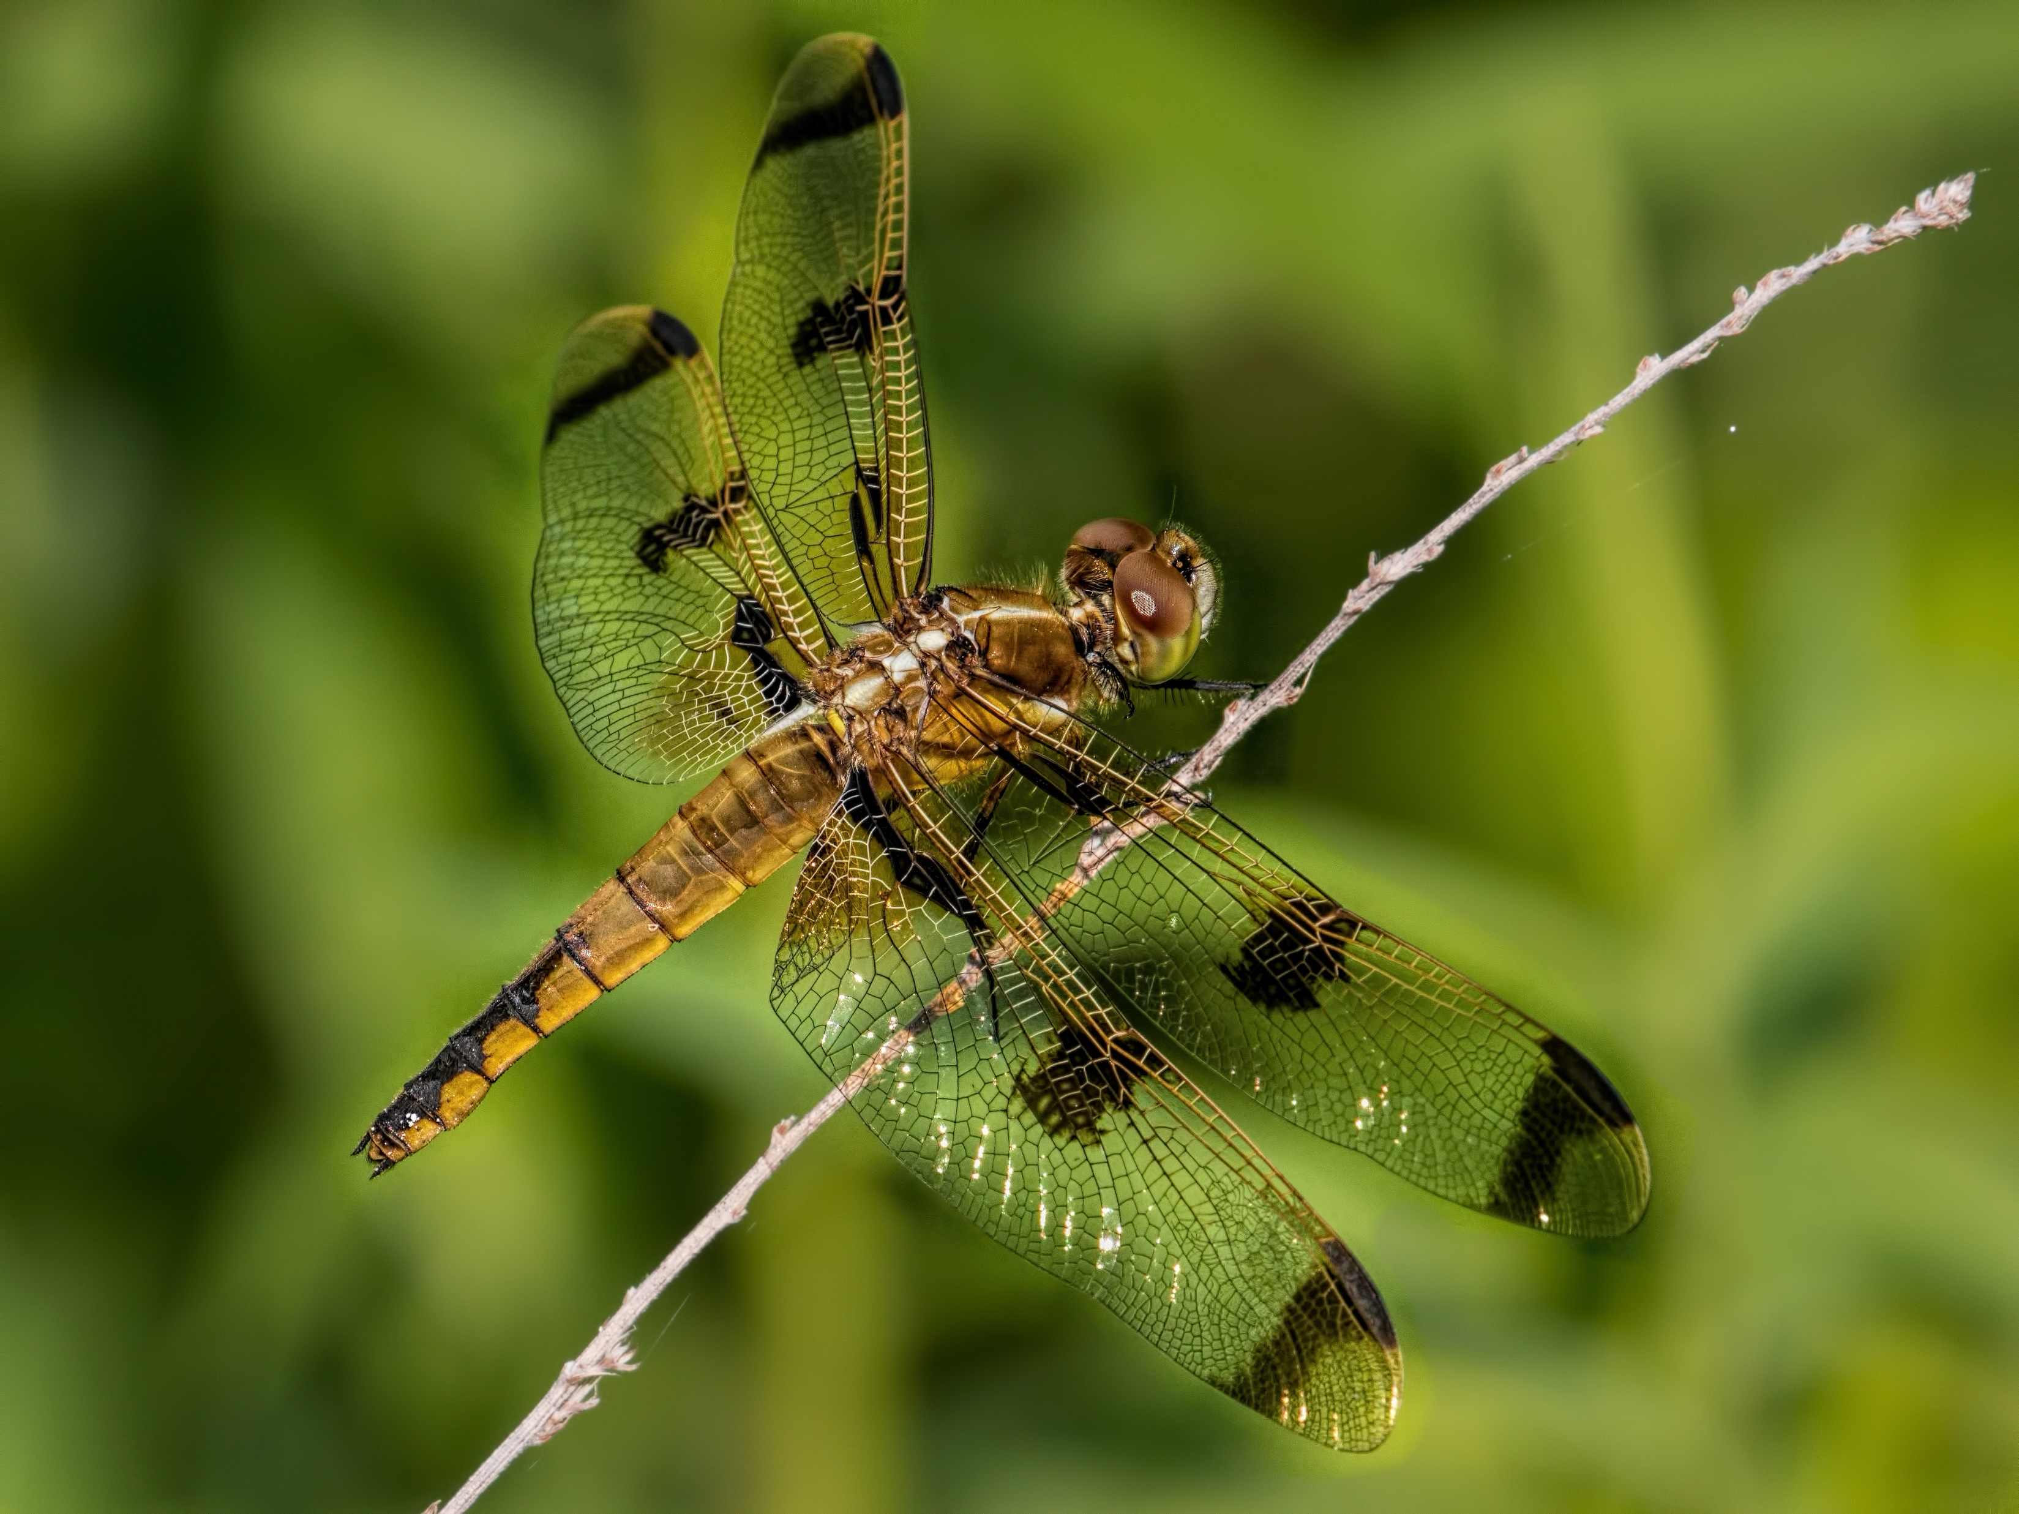
Dragonfly ID Quiz
Total Score:
8/10
Click to Retake Quiz

